Slide 1
Introduction to Qur’an

Slide 2
Lecture contents
The Book of Allah (AL-QUR’AN)
The title of Qur’an.
The definition of Al-Qur’an
The authenticity of Qur’an
The compilation of Qur’an
The inimitability of Qur’an
The intelligibility of Qur’an
Qur’an, the book of principle guideline (Details in Sunnah)

Slide 3
The title of Qur’an
Al-Kitab :The only book among all the books in the World which deserve to be called a book is the Holy Qur’an.
Al-Furqan : The Criterion: which can distinguish between truth and falsehood.
Al-zikr :The advice

Slide 4
The definition of Qur’an
The word of Allah that were revealed to His Messenger ﷺ,written in books and narrated continuously to us without any doubt.
(القرآن ھوالمنزل علی الرسول المکتوب فی المصاحف المنقول الینا نقلامتواترابلاشبھۃ)

Slide 5
Content of Qur’an
114 chapters/ Suras
6666/6236verses
30 Parts/ juz
14 sujud
7 manazil
558 Ruku

Slide 6
The authenticity of Qur’an
“Say if all humankind and all Jinns were together to produce the like of this Qur’an, they could not produce the like thereof, even if they backed up each other with help and support” 17/88
“Do people imagine that this Qur’an is not from Us, and that you, O Prophet are falsely attributing to us? Tell them that if they are speaking truly they should produce ten surahs resembling the Qur’an, and that they are free to call on the aid of anyone but God in so doing.” (11:13)
“And you (O Muhammad) did not recite any book before this, nor you were able to transcribe one with your right hand. In that case, indeed those who talk vanity could have doubted.” (29:48).

Slide 7
History of Scriptures
History of Scriptures
• Civilizations are build on books
• Vast majority of human civilizations are built
fundamentally from books
• In the 9th century there civilizations were built
on Greek epic poet [Homer- Iliad & Odyssey]
these are the greatest works of western
civilizations
• Greek civilizations are fundamentally derived
from Ho

Slide 8
continued
• For Hebrew it’s the Torah became the
fundamental book for western and European civilizations
• Bible became the fundamental book first in Greek then in Latin
• For English people it was the King James Bible
• For Arabs there wasn’t a book in the Arabic language until the Qur’an

Slide 9
Compilation Of Quran
• They began to collect and set the criteria
• Criteria is each piece of Quran must be brought and had written in the presence of Prophet with two witnesses
• It took them while but they did it
• They made into one compilation written on gazelle skin( Leather)
• Previously it was written on shoulder blades of Camels, Ribs, Stones, and Wood
• They compiled into one Quran
• Umar kept it and later on gave it to his daughter Hafsa
• At the time of Usman the third caliph, there was a Dispute in Azerbaijan regarding differences In recitations of the Quran • There was no standardized writing of Quran

Slide 10
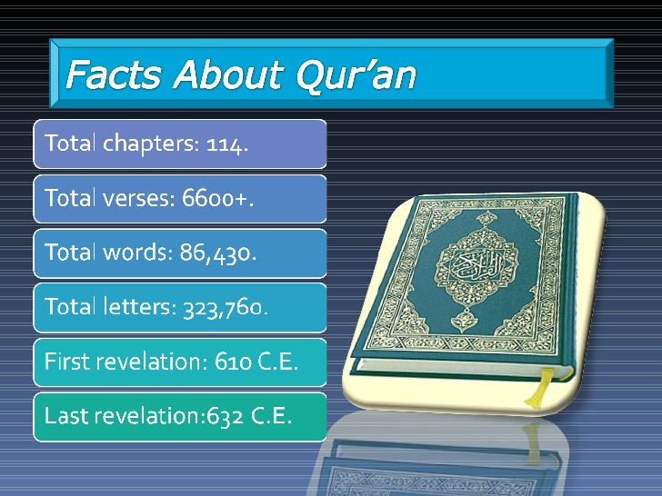

Slide 11
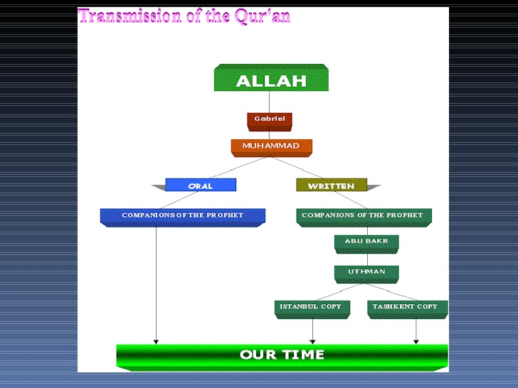

Slide 12
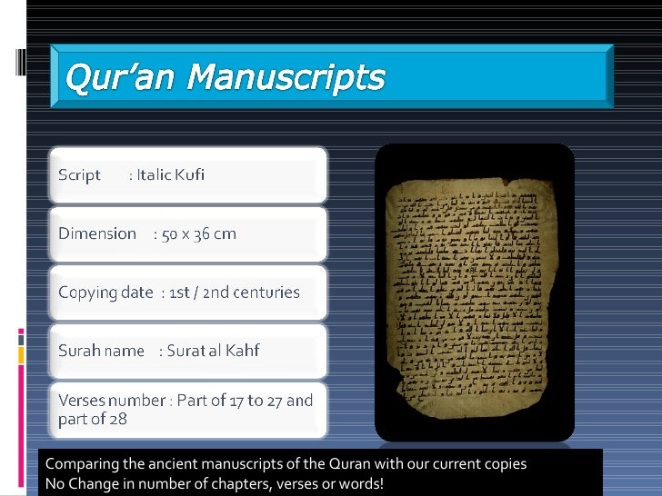

Slide 13
